Slide 1
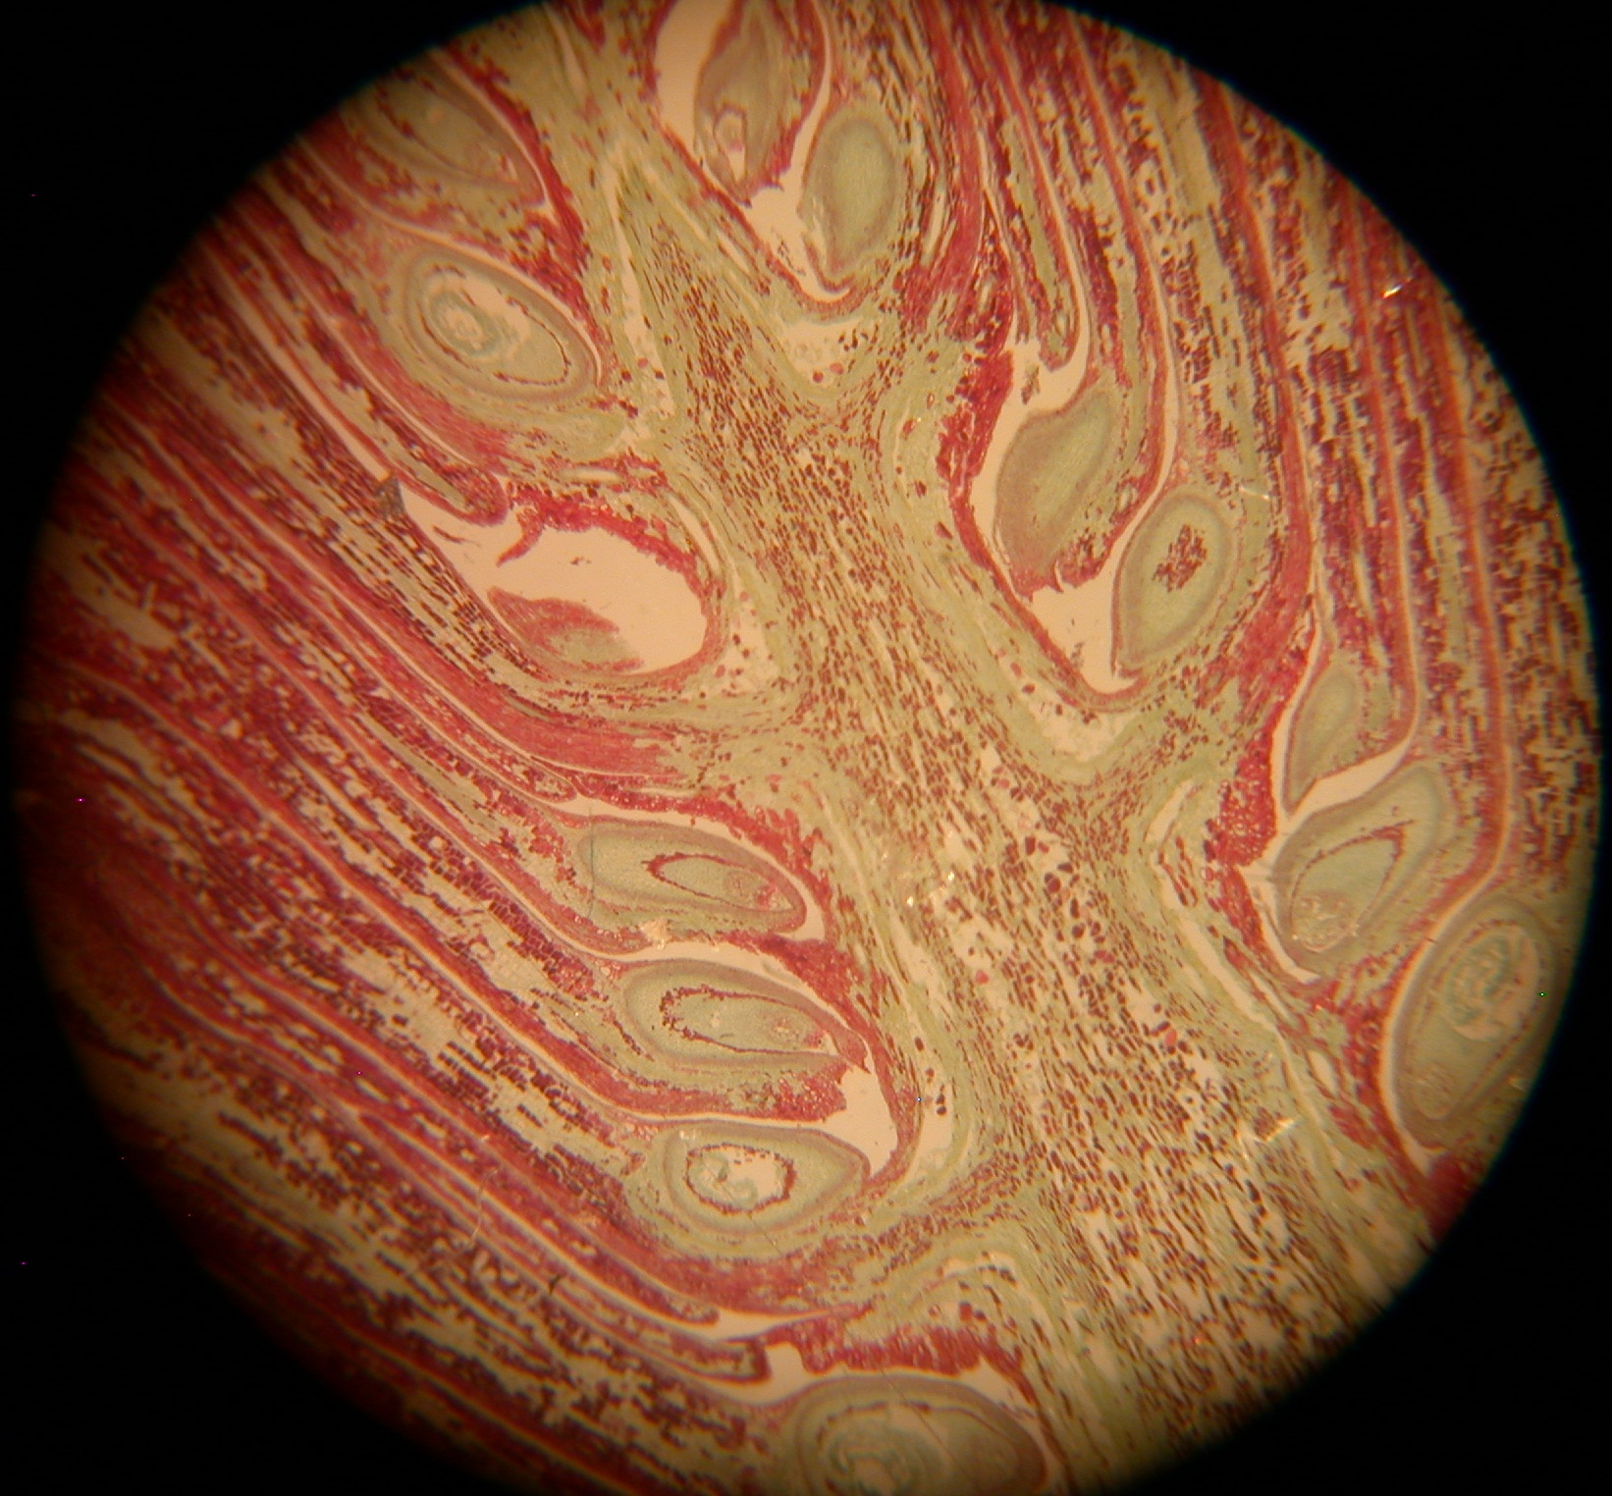
Ovule
eggs (n) will form inside the female gametophyte within the megaspore (n) formed by the megasporocyte (2n)
Plant group: Gymnosperm
Phylum Coniferophyta,
Structure: pine ovulate cone

